Slide 1
Remote scan & Recognition of Human's Signature
BAROUH Victor – DELESTRE Clément – DULONG DE ROSNAY Jean – TERBECHE Alan – YANG Saly
Transport and Telecommunications Institute

Slide 2
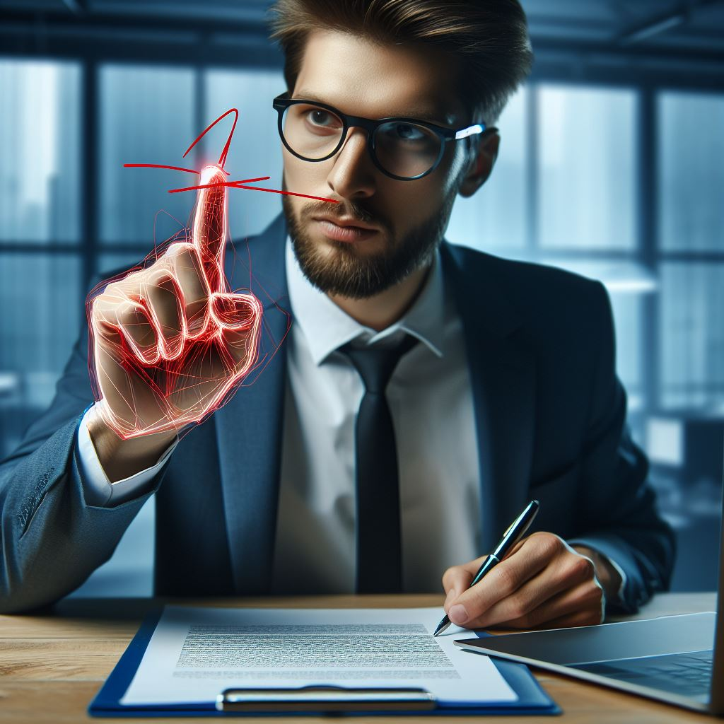
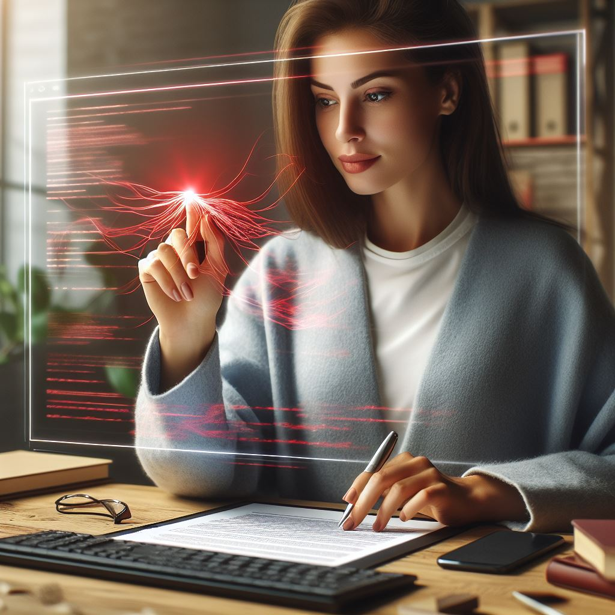
Introduction
Introduction
Signature
COVID-19 impacted our interaction habits, including how we sign documents.
Traditional methods involving passing materials like pens hand to hand could be challenging in the advent of another pandemic.
Digital signatures have become essential for document signing.
Signing documents with a simple hand gesture is intriguing in this context.
BAROUH Victor – DELESTRE Clément – DULONG DE ROSNAY Jean – TERBECHE Alan – YANG Saly
Notes:
Intro avec le contexte covid / un besoin de sans contact pour les signature par ex

Slide 3





Table of content
Table of content
Signature
Previous project work
II. Problematics
III. Our objectives
IV. Implementation
Stereo vision, Depth Anything, Algorithm improvement, Smoothing the curve, Cloud Points
V. Conclusion
BAROUH Victor – DELESTRE Clément – DULONG DE ROSNAY Jean – TERBECHE Alan – YANG Saly

Slide 4
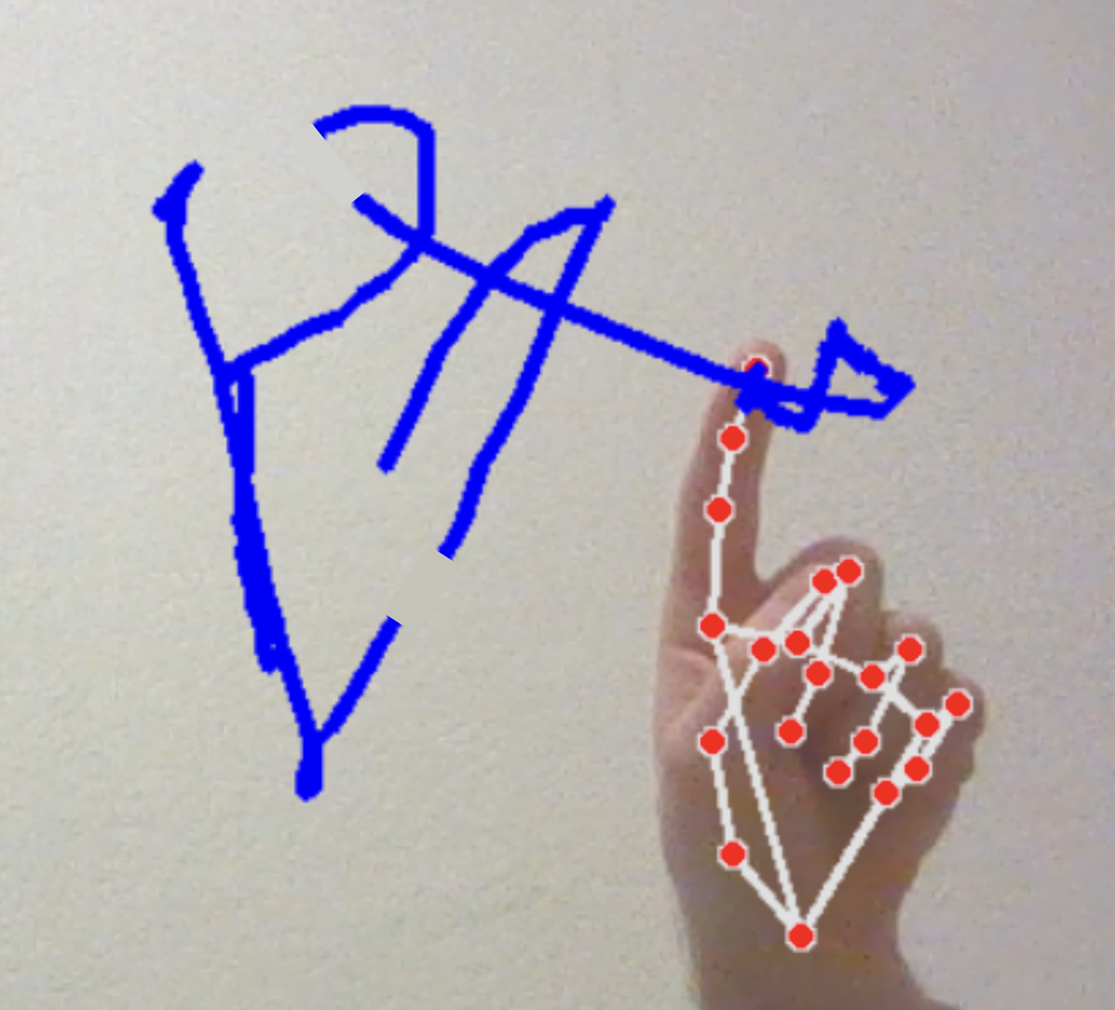

Previous project work
Status
Signature
Process of signature is working :
The camera can track a Hand
The X, Y, Z axis are computed
One person can draw a signature
Problems:
Signatures are cut at some points
Finger detection
BAROUH Victor – DELESTRE Clément – DULONG DE ROSNAY Jean – TERBECHE Alan – YANG Saly

Slide 5
Problematics
Problematics
Signature
We have identified several problems in the previous system:
Presence of discontinuities in the signature tracing. The line stops when it shouldn't.
Conversely, when there is a space in the signature, the line does not stop when it should.
The beginning and end of the signature are not identified. When the user finishes signing, the line continues.
The depth is dependent of a static focal point of the camera, when the webcam has a variable focal point
BAROUH Victor – DELESTRE Clément – DULONG DE ROSNAY Jean – TERBECHE Alan – YANG Saly

Slide 6
Objectives
Objectives
Signature
Implement a stereo video feed to compute an accurate depth
In the impossibility of doing so, using competent software
Improve the recognition algorithm to reduce the interruptability of tracking
Smoothing the resultant signature
BAROUH Victor – DELESTRE Clément – DULONG DE ROSNAY Jean – TERBECHE Alan – YANG Saly​

Slide 7
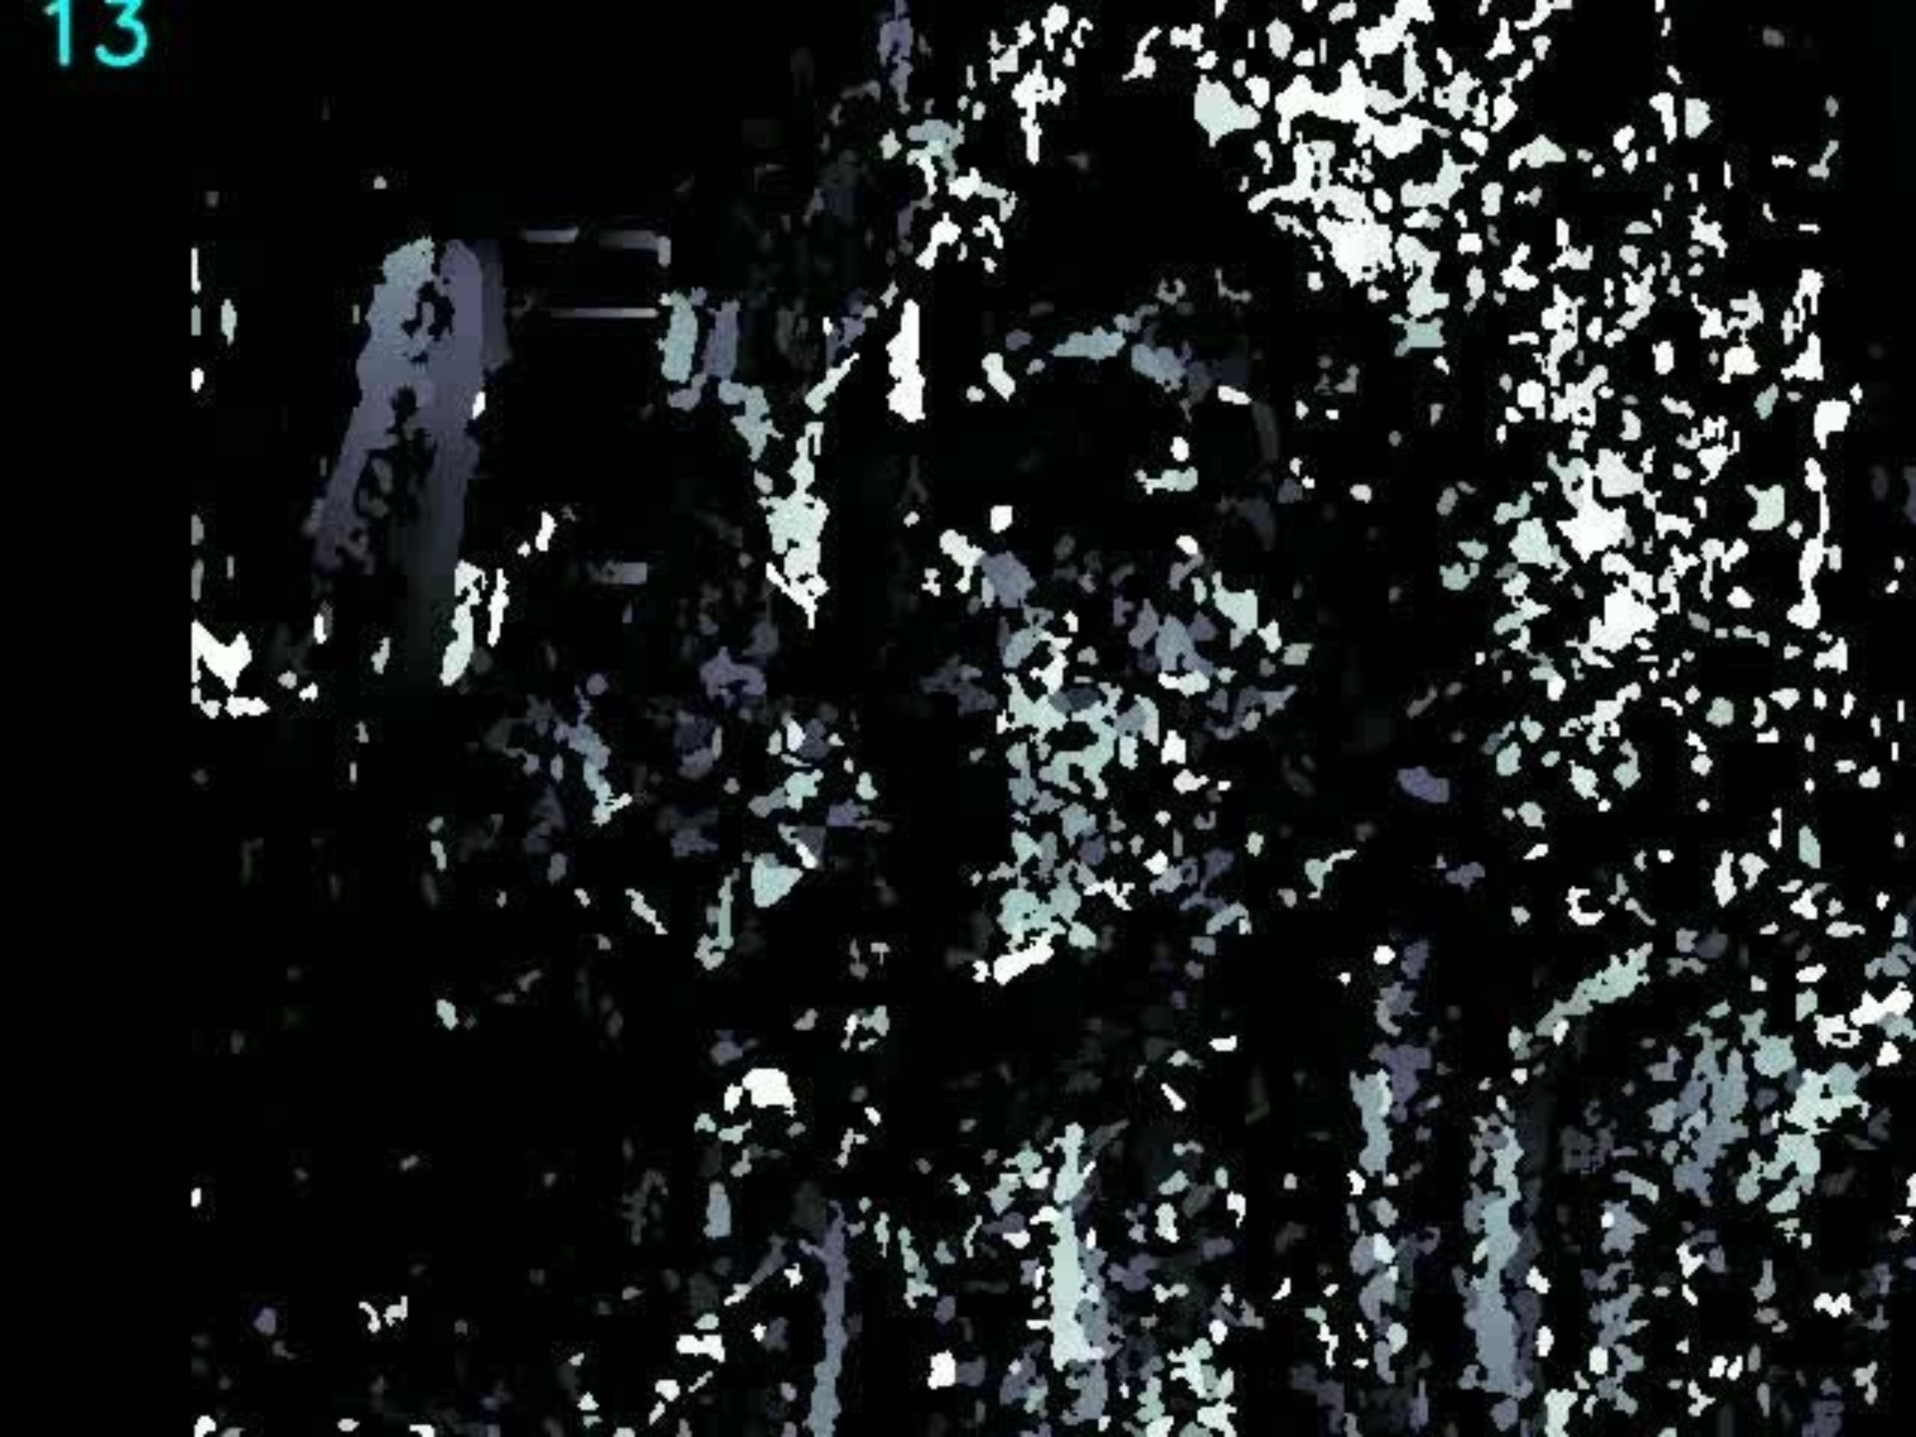
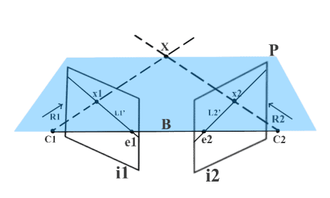
Stereo video feed implementation
Implementation
Signature
Smartphone
webcam
Using two cameras: webcam and smartphone
And epipolar geometry
We tried to compute a depthmap
Epipolar geometry, learnopencv
BAROUH Victor – DELESTRE Clément – DULONG DE ROSNAY Jean – TERBECHE Alan – YANG Saly​

Slide 8
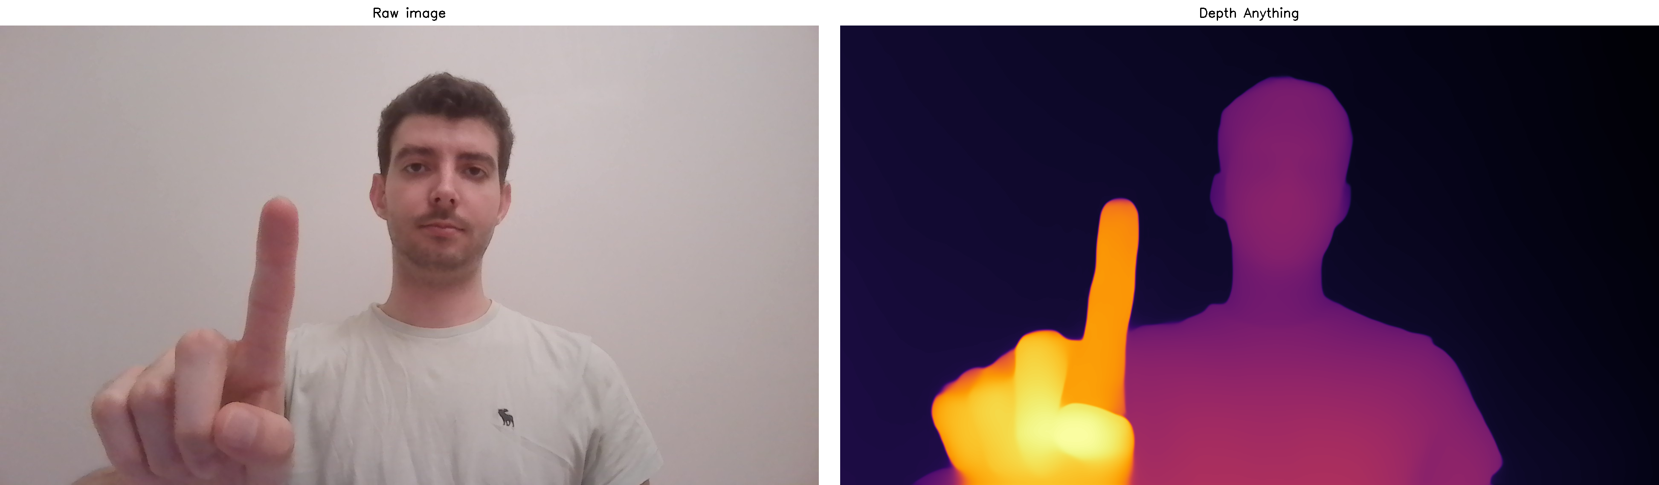
Detect the beginning and end of the signature gesture.
Implementation
Signature
Attempted Technology: Depth-Anything
Reasoning:
Calculate the distance between the index finger and the camera.
When the finger is close enough, the user is considered to be writing.
When the finger moves away, the user is no longer writing.
Result :
Not convincing: Depth-Anything is slow in certain computations and is complicated to implement in Python.
BAROUH Victor – DELESTRE Clément – DULONG DE ROSNAY Jean – TERBECHE Alan – YANG Saly​

Slide 9
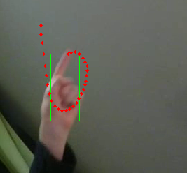

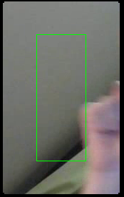
Improvement of algorithm
Implementation
Signature
To detect and track the hand, we use mediapipe google
The application is efficient
But cannot recognized when there is too much motion blur
BAROUH Victor – DELESTRE Clément – DULONG DE ROSNAY Jean – TERBECHE Alan – YANG Saly​

Slide 10
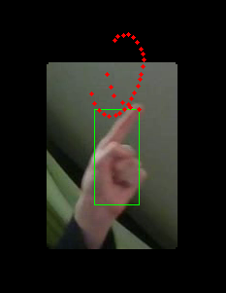
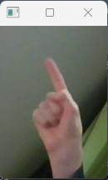
Improvement of algorithm
Implementation
Signature
The idea to improve it is to crop the picture where the hand could be. We also test if masking the rest of the frame would help
We also reduce the detection threshold of the hand according to the cropping/masking of picture :
Masking frame
The hand should be easier to recognize
The computation should be quicker
Cropping frame
BAROUH Victor – DELESTRE Clément – DULONG DE ROSNAY Jean – TERBECHE Alan – YANG Saly​
Notes:
In cropping shape change.

Slide 11
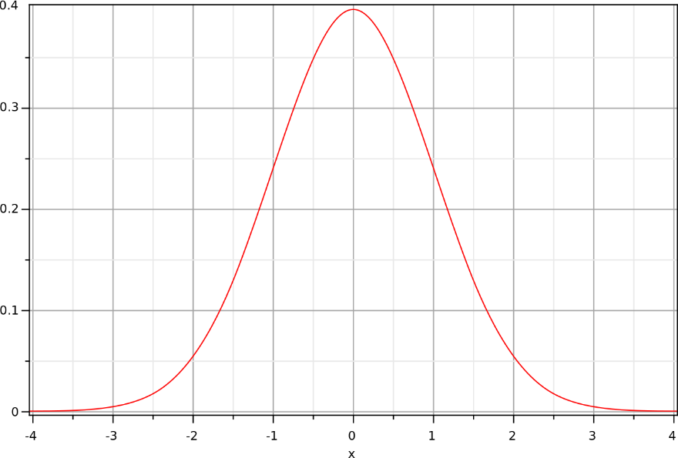
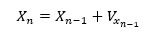
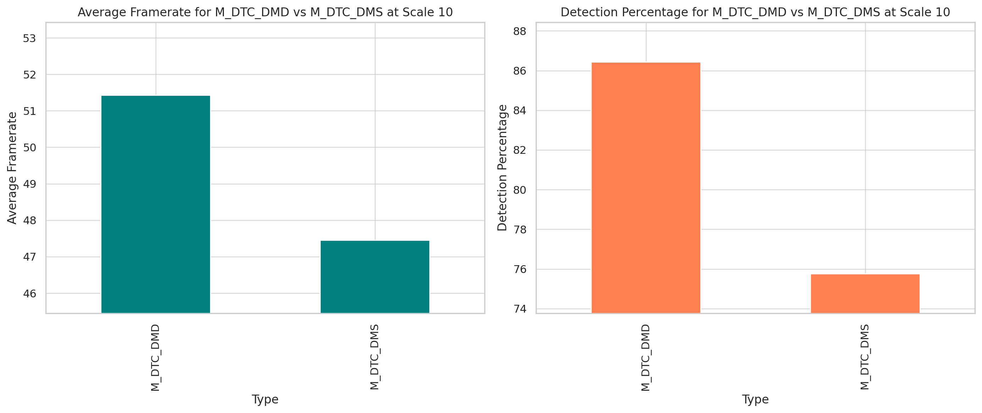
Improvement of algorithm
Implementation
Signature
Normal law to get an area
The first step to crop the frame, is to estimate where the hand should be.
We tried two algorithms:
BAROUH Victor – DELESTRE Clément – DULONG DE ROSNAY Jean – TERBECHE Alan – YANG Saly​

Slide 12
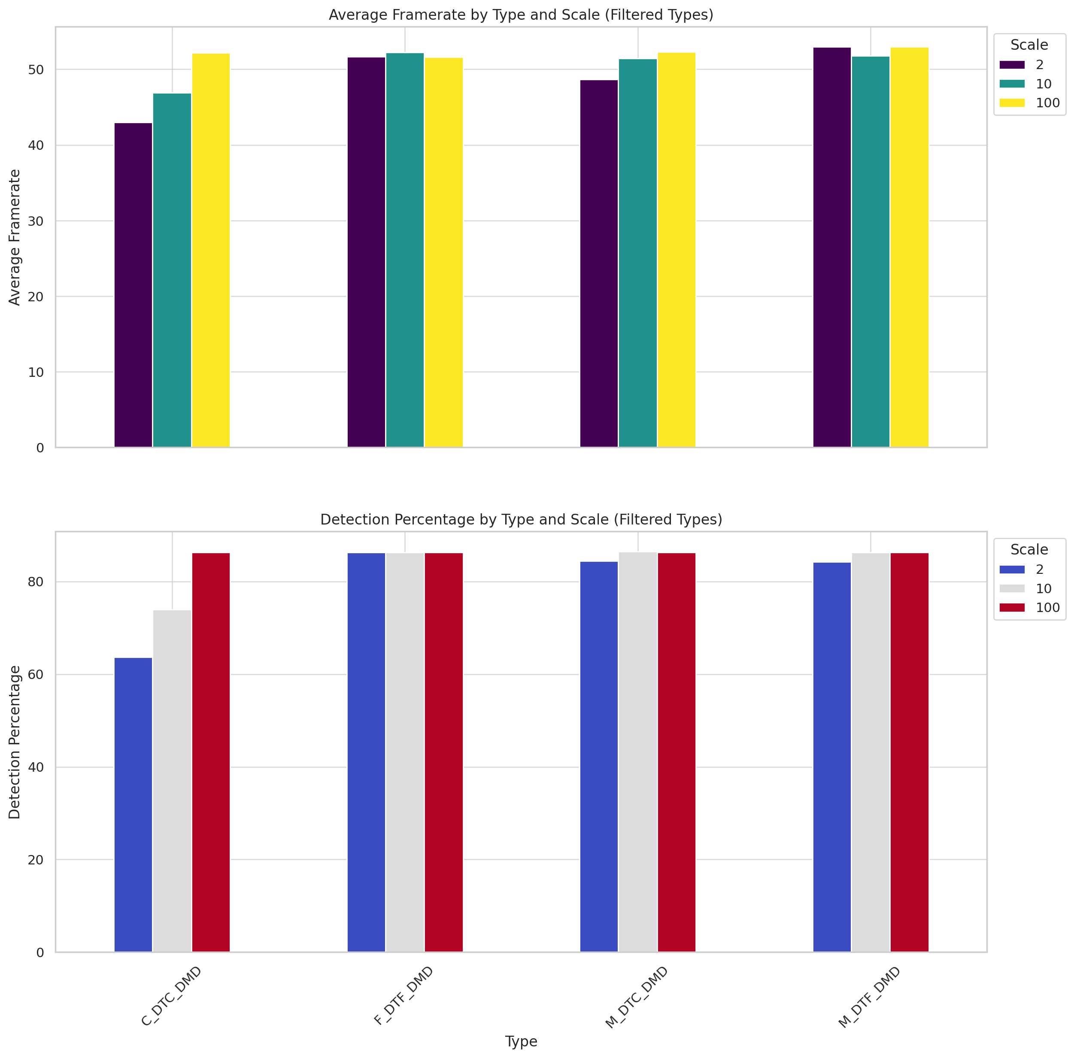
Improvement of algorithm
Implementation
Signature
A benchmark shows:
Cropping mostly reduce computation time and efficiency
Masking has relatively the same result as no preprocessing the frame
When masking and keeping a detection threshold at 0.7, the algorithm perform slightly better.
BAROUH Victor – DELESTRE Clément – DULONG DE ROSNAY Jean – TERBECHE Alan – YANG Saly​

Slide 13
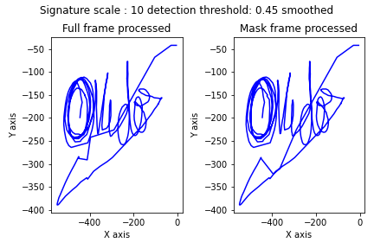
Improvement of algorithm
Implementation
Signature
The algorithm seems equivalent, whether the frame is pre-processed or not.
But, the hand tracking result is not.
BAROUH Victor – DELESTRE Clément – DULONG DE ROSNAY Jean – TERBECHE Alan – YANG Saly​

Slide 14
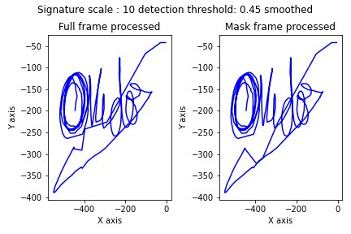
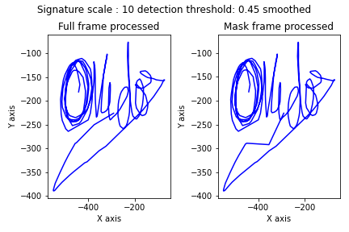
Smoothing the curve
Implementation
Signature
The algorithm still have interruptions, or the hand is not recognized properly.
We decided to use Bézier curves to smooth and compute missing points.
BAROUH Victor – DELESTRE Clément – DULONG DE ROSNAY Jean – TERBECHE Alan – YANG Saly​

Slide 15
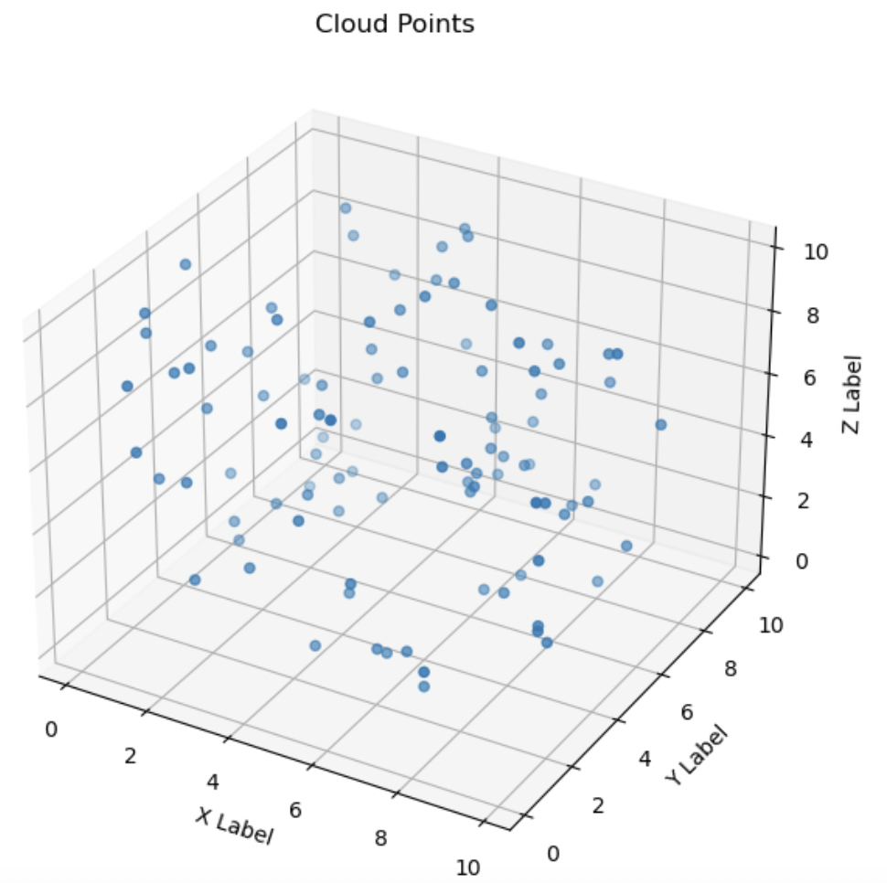
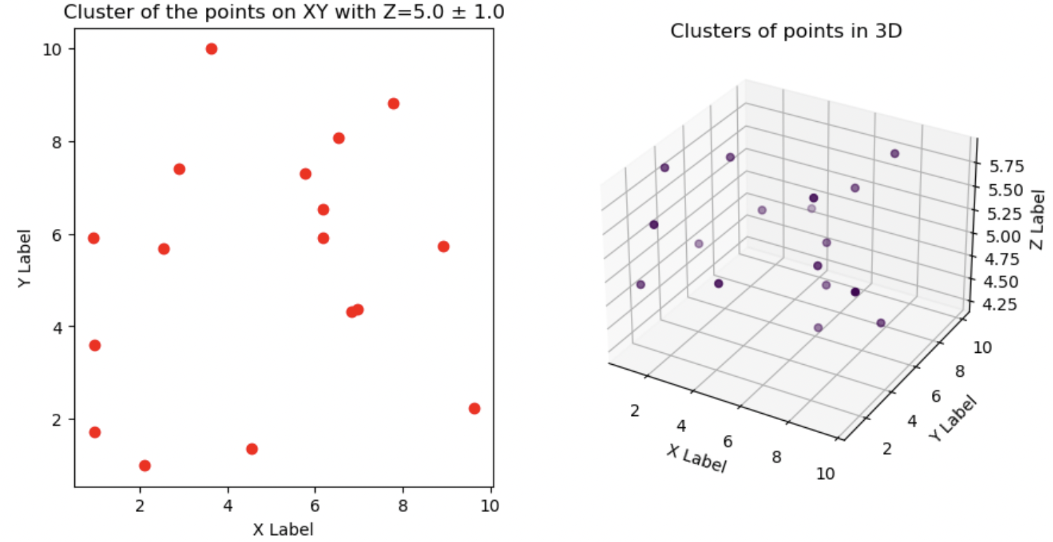
Cloud points
Implementation
Signature
Final signature by Cluster in Cloud points
A projection of the signature to a coherent plan
BAROUH Victor – DELESTRE Clément – DULONG DE ROSNAY Jean – TERBECHE Alan – YANG Saly​

Slide 16
Conclusion
Conclusion
Signature
We could not implement a satisfactory depth estimation
It is proposed that to improve the stereo method, there would need specialised devices (Twices same cameras)
Or It is proposed to place the second camera so it can see both the hand and the webcam and use that to compute the distance.
2. It was considered impossible to use monocular machine learning depth on live feed
3. It was shown that cropping the frame reduced performance, and masking only very slightly increased them
4. We added algorithm to interpolate the resulting signature with Bézier's curves
BAROUH Victor – DELESTRE Clément – DULONG DE ROSNAY Jean – TERBECHE Alan – YANG Saly​

Slide 17
Acknowledgements
Acknowledgements
Signature
We would like to express our appreciation to the school for providing us with the opportunity to work on this project.
Additionally, we are grateful to our supervisor, Professor Aleksandrs Grakovskis, for guiding us throughout the realization process.
BAROUH Victor – DELESTRE Clément – DULONG DE ROSNAY Jean – TERBECHE Alan – YANG Saly​

Slide 18
Thank you for your attention!
BAROUH Victor – DELESTRE Clément – DULONG DE ROSNAY Jean – TERBECHE Alan – YANG Saly

